Slide 1


Is RabbitMq a copy of Correos?
RabbitMq
© 2021 ThoughtWorks

Slide 2

Key concepts
GLOBAL SOFTWARE CONSULTANCY
Alejandro Batanero pairing with Emilly Karungi
© 2021 ThoughtWorks

Slide 3
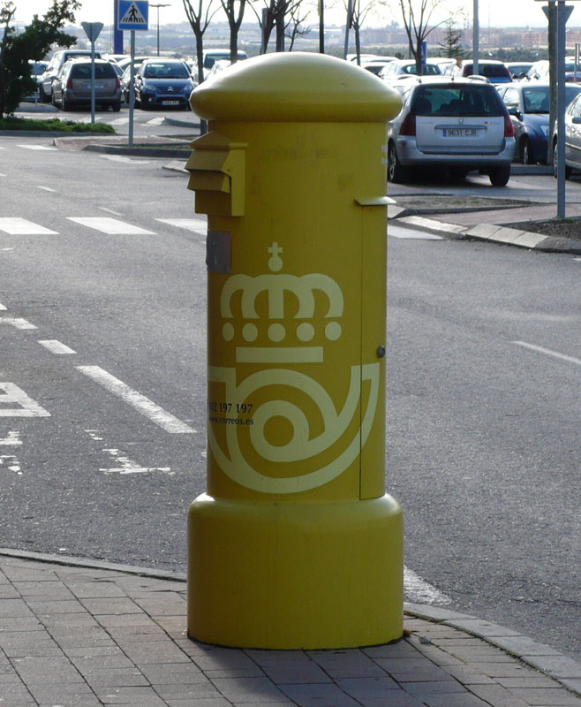

Producer
- Your friend
Exchange
- The correos Mailbox
Queue
- Mailbox in your front door
Routing key
- The address in the mail
Binding key
- The address in your front door
Consumer
- You
A friend sending you a mail

Slide 4
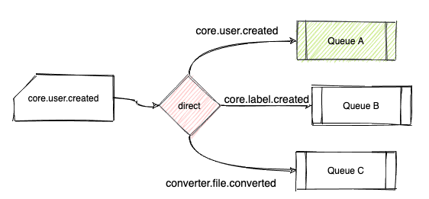
Exchange types - Direct - A friend sending you a mail
routingKey == bindingKey

Slide 5
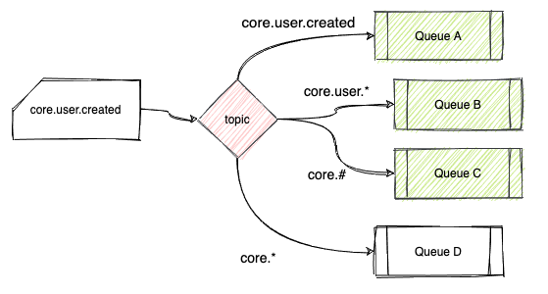
Exchange types - Topic - Sending the city business numbers
routingKey == regex(bindingKey.{*}.{#})

Slide 6
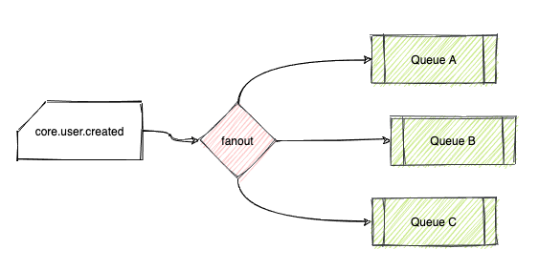
Exchange types - Fanout - Political propaganda
true == true

Slide 7
Exchange types - Headers
X-match { any, all }

Slide 8
Simulator!
GLOBAL SOFTWARE CONSULTANCY
http://tryrabbitmq.com/
© 2021 ThoughtWorks

Slide 9
Cars for the people
Create a RabbitMq architecture for the following problem
You are selling cards for different markets (coches.com, cars.com, segundamano.es). So in your company you have a backoffice to create a car listing and you want to populate that listing to the different markets. Can we make it so we don’t need to modify the backoffice everytime that a new market is added?

Slide 10
2. File types
Create a RabbitMq architecture for the following problem
In your company you convert files (doc, xls, csv, etc..) to pdf. So, create an arc to be able to add new file types convertors easily.

Slide 11
3. Event bus
Create a RabbitMq architecture for the following problem
You need an event bus in your company to communicate between microservices. All the microservices should publish to the same event bus and can subscribe to the events on it.
Every consumer should be able to subscribe/consume to:
An specific event
All the events of an aggregate type
All the events of the bounded context
The event names are something like shipments.order.created

Slide 12
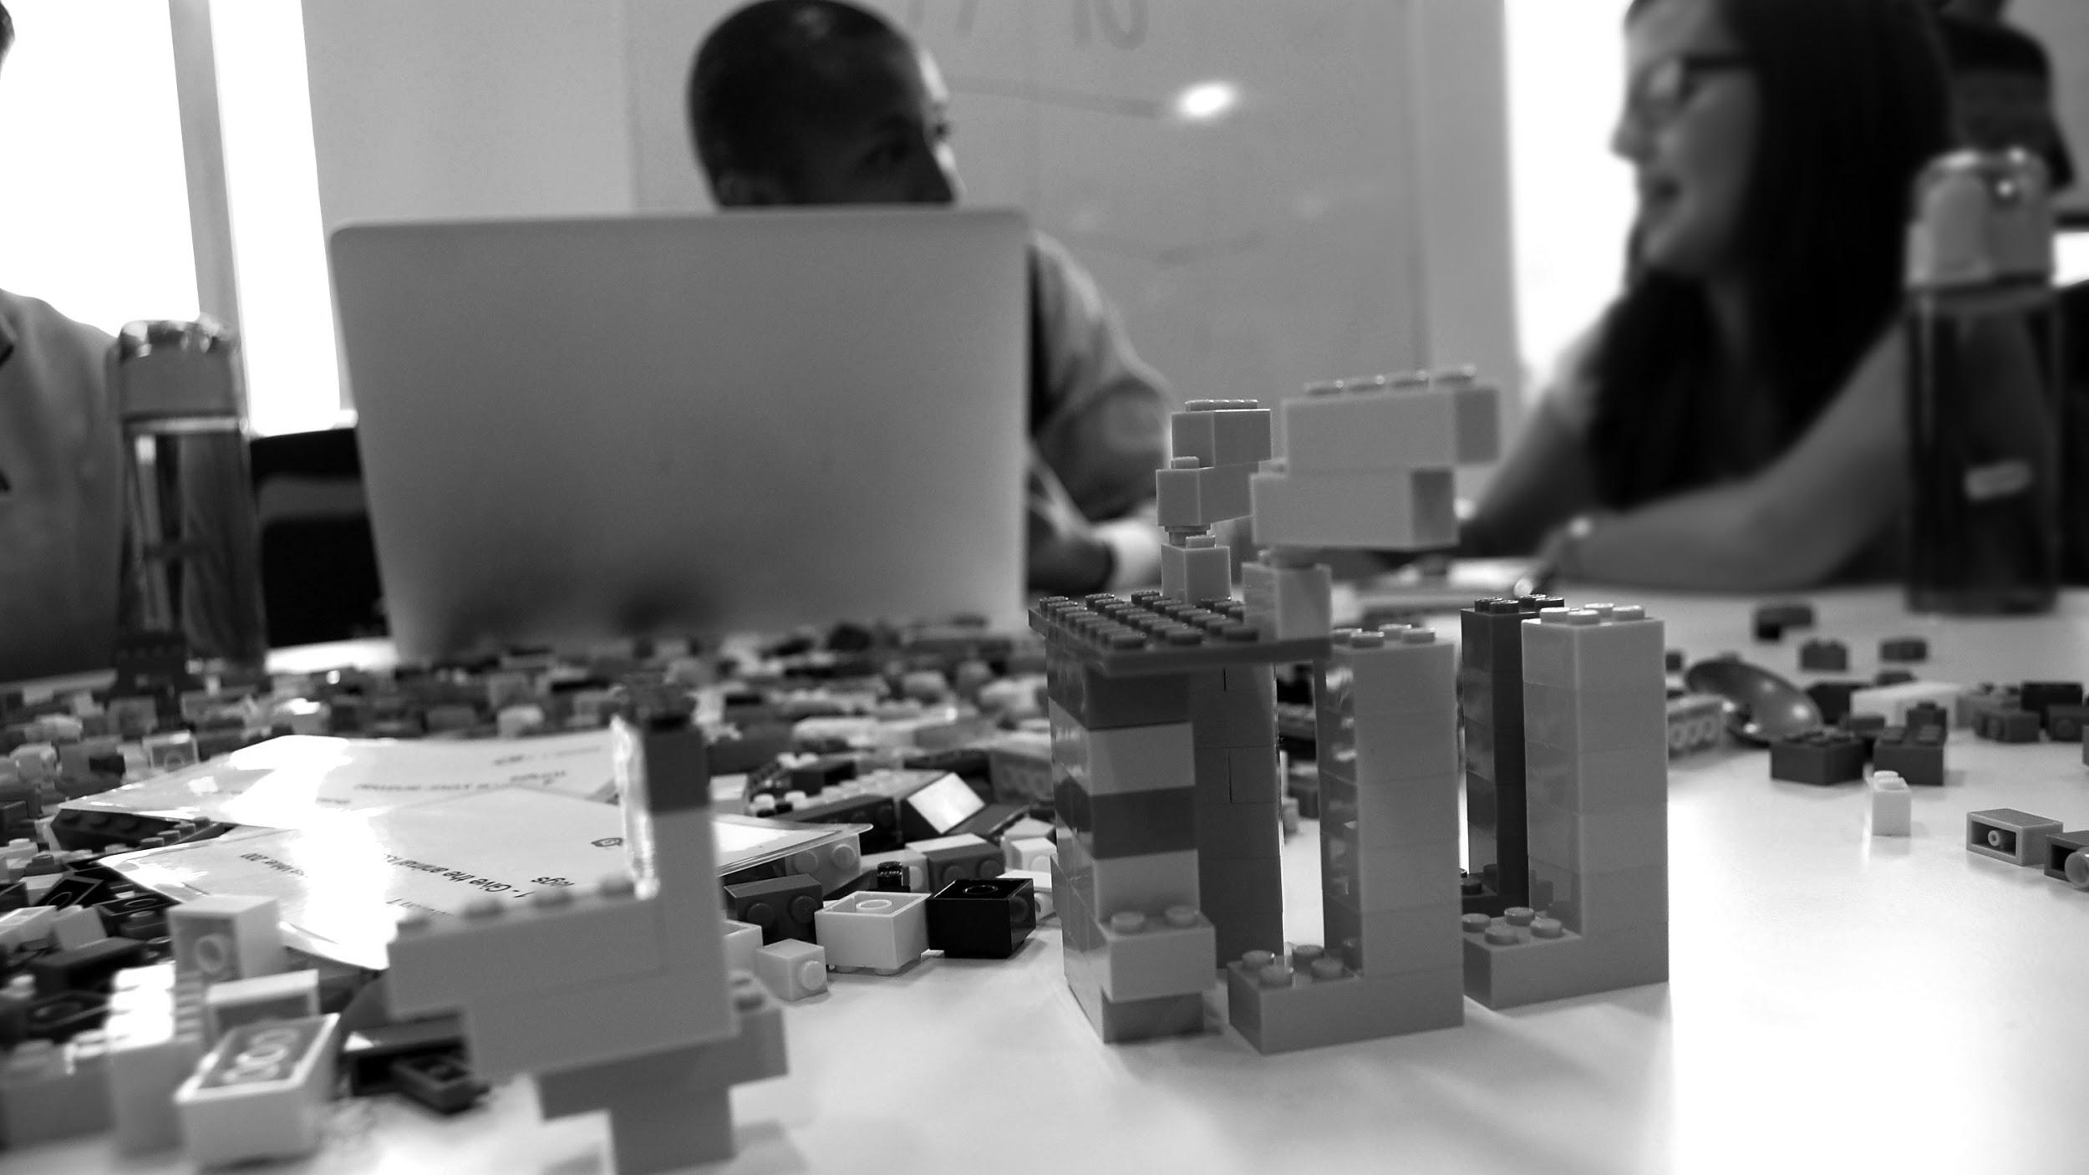
Other messaging systems
© 2021 ThoughtWorks

Slide 13
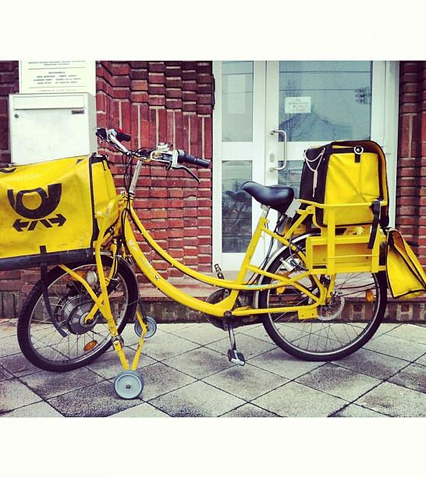
SNS + SQS
RabbitMq
Kafka
Tuk Tuk

Slide 14

THANKYOU
ALEJANDRO BATANERO SENIOR CONSULTANT DEVELOPER
alejandro.batanero@thoughtworks.com | thoughtworks.com
© 2021 ThoughtWorks

